Slide 1
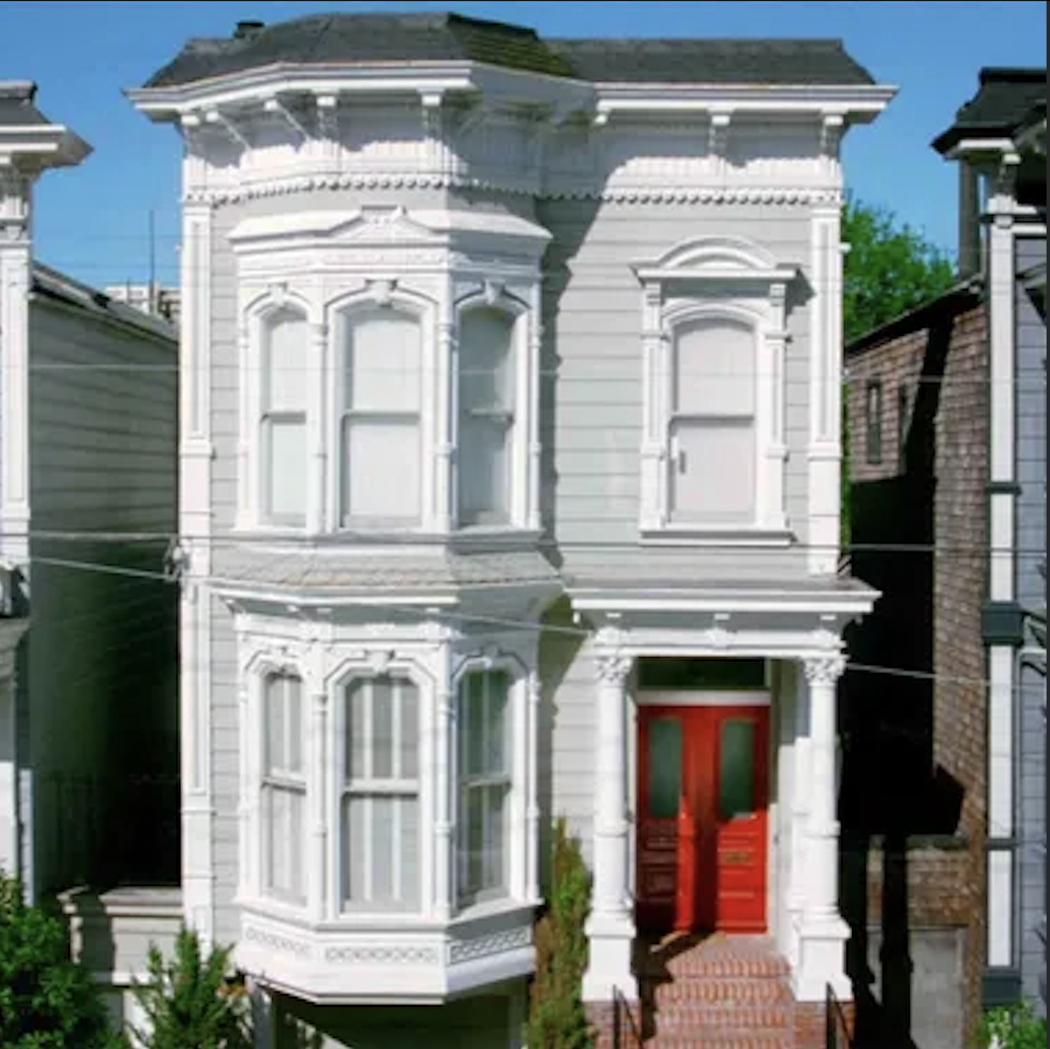
San Francisco 1990’s
Housing Price Prediction
By Anthony Medina

Slide 2
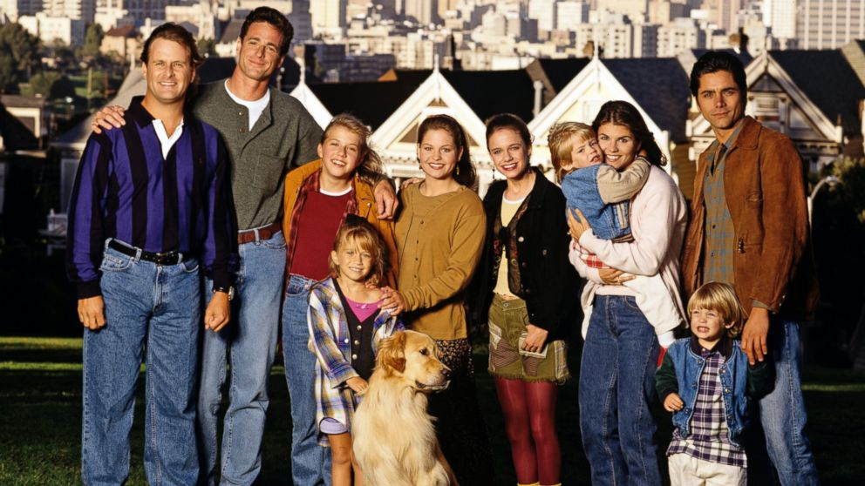
How much does it cost to live in San Francisco?
This project explores the 1990 census data to see what type of housing a family could afford.

Slide 3
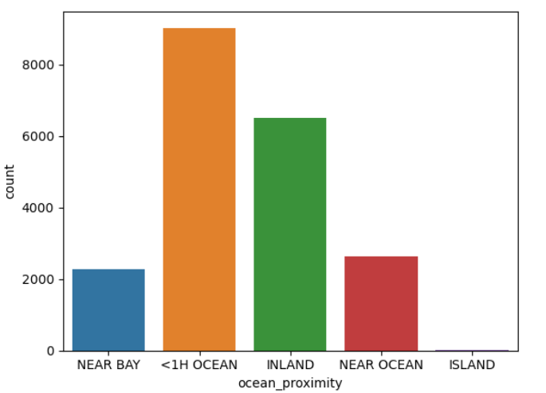
How much will it cost to live in these places?

Slide 4

First we dig through the data…
What do we find?
Missing Values
Skewed Distributions
Outliers
Correlations

Slide 5

Who about missing data?
Remove
Mean
Median
Zero

Slide 6

Pre-Processing Data Steps

Slide 7
Model Metrics
 | R-Squared | MSE | RMSE
Linear Regression | 0.635 | 490786835.53 | 70056.18
Polynomial Regression | -1.617 | 2.17e+30 | 1474906910786894.8
Ridge Regression | 0.634 | 4912746344.80 | 70090.99
Lasso Regression | 0.635 | 4907950136.07 | 70056.76

Slide 8
Model Choice: Linear Regression
Tied for best R-Squared
Almost the best MSE (But really close to tied for best)
Almost the Best RMSE (But really close to tied for best)
Easily the least complicated of the models.

Slide 9
What did the model have to say?
Predicted 1990’s Prices
Inland: $417,603.01
Island: $426,431.03
Near Bay: $385,457.96
Near Ocean: $326,171.32
Ocean Front: $257,276.63
Adjusted 2023 Prices
Inland: $967,883.48
Island: $989,773.50
Near Bay: $894,672.40
Near Ocean: $757,064.35
Ocean Front: $597,157.40

Slide 10
Further questions
How does the scaled model compare to the actual values of today’s housing in San Francisco?
What other models would we have used for to predict a price?
Would there be a significant difference if we dealt with missing values differently?

